Slide 1

COVID-19 DATA ANALYSIS
By: Swati Taheem (07213702020)
: Parshav Kumar (04813702020)

Slide 2


TABLE OF CONTENTS
01
02
03
04
Introduction
Objective
Scope
Diagrams

Slide 3

Covid-19 Virus
COVID-19 is caused by the SARS-CoV-2 virus. COVID-19 can cause mild to severe respiratory illness, including death.
The best preventive measures include getting vaccinated, wearing a mask during times of high transmission, staying 6 feet apart, washing hands often and avoiding sick people.
In general, people with COVID-19 have some of the initial following symptoms:
Fever
Cough
Shortness of breath or difficulty breathing
Headaches
Sore throat
Congestion or runny nose

Slide 4
Global Spread Of Covid-19
The COVID-19 pandemic is making the world suffer, and the race between virus mutation and anti-epidemic measures including vaccine development is intensifying. This once-in-a-century health crisis will exert impact upon human society for decades.
So, to maintain records and visualizing it in a proper manner we need technique and tools.
Datasets:
Country wise Covid cases till June 2022
State wise Covid cases of India till June 2022

Slide 5

Objective
Most of the prior research, media and projects coverage focused on the number of infections in the entire country. However, given the size and diversity of India, it is important to look at the spread of the disease in each state separately, wherein the situations are quite different. In this project, we aim to analyse covid data on the number of infected people in each Indian state.
Also we see the covid-19 data of each country in the world graphically.
And the prediction of covid-19 on the basis of the dataset which only contains the initial clinical symptoms will also help various organisation to check their employees or staff whether they are affected or healthy to enter.

Slide 6
COMMON SYMPTOMS
Fever
Shortness of Breath
Headache
Sore Throat

Slide 7

Future Scope
General-purpose prediction model for any disease
Idea for more Accurate analysis of this kind of disease
Visualization and prediction of huge data in an organised way.
Understandable for both human and a technical person.
Easier to manage records and also helpful for an organization, if used.

Slide 8
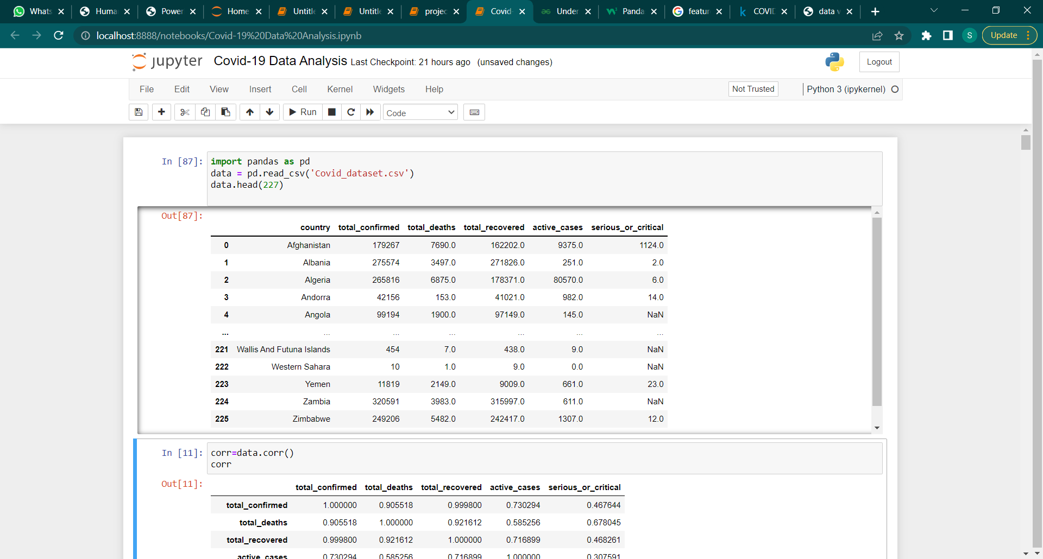
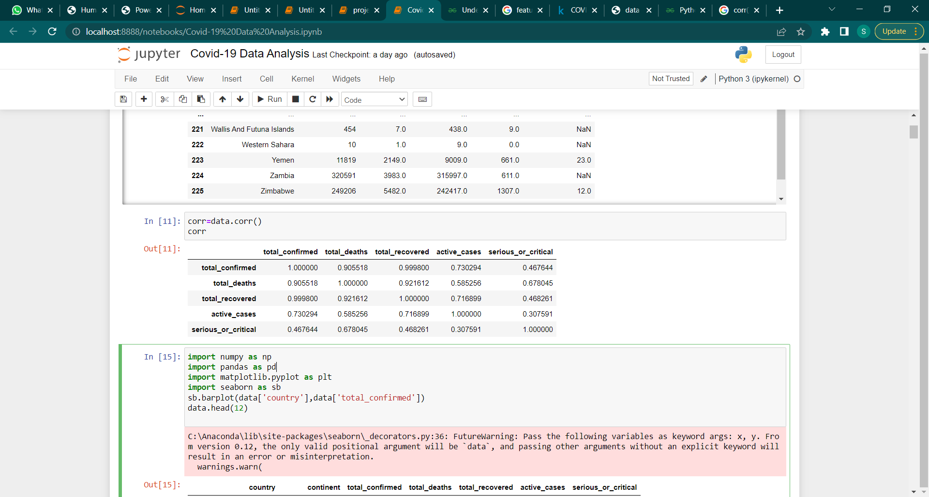
Country wise Covid cases till June 2022
Hers the record of the data , we have on the world basis and correlation between them

Slide 9
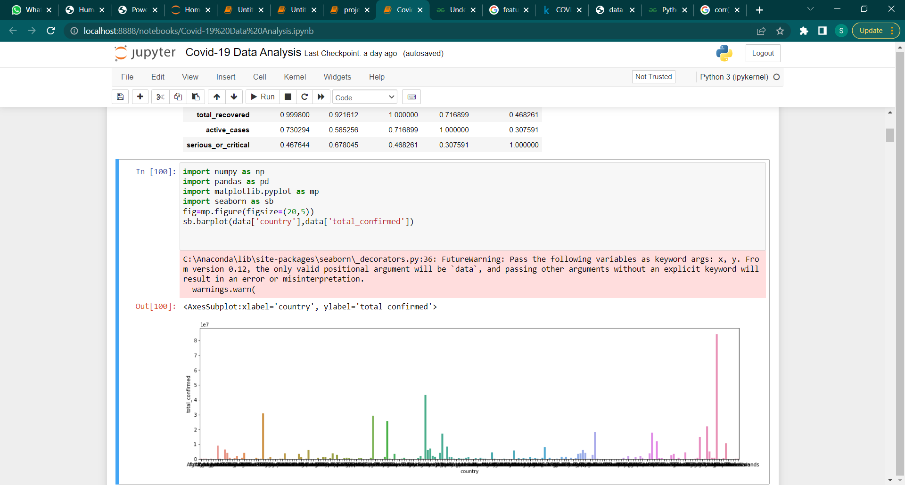
Country wise Covid cases till June 2022
Below is the representation of data of all countries together but visualization is not clear and understandable.

Slide 10
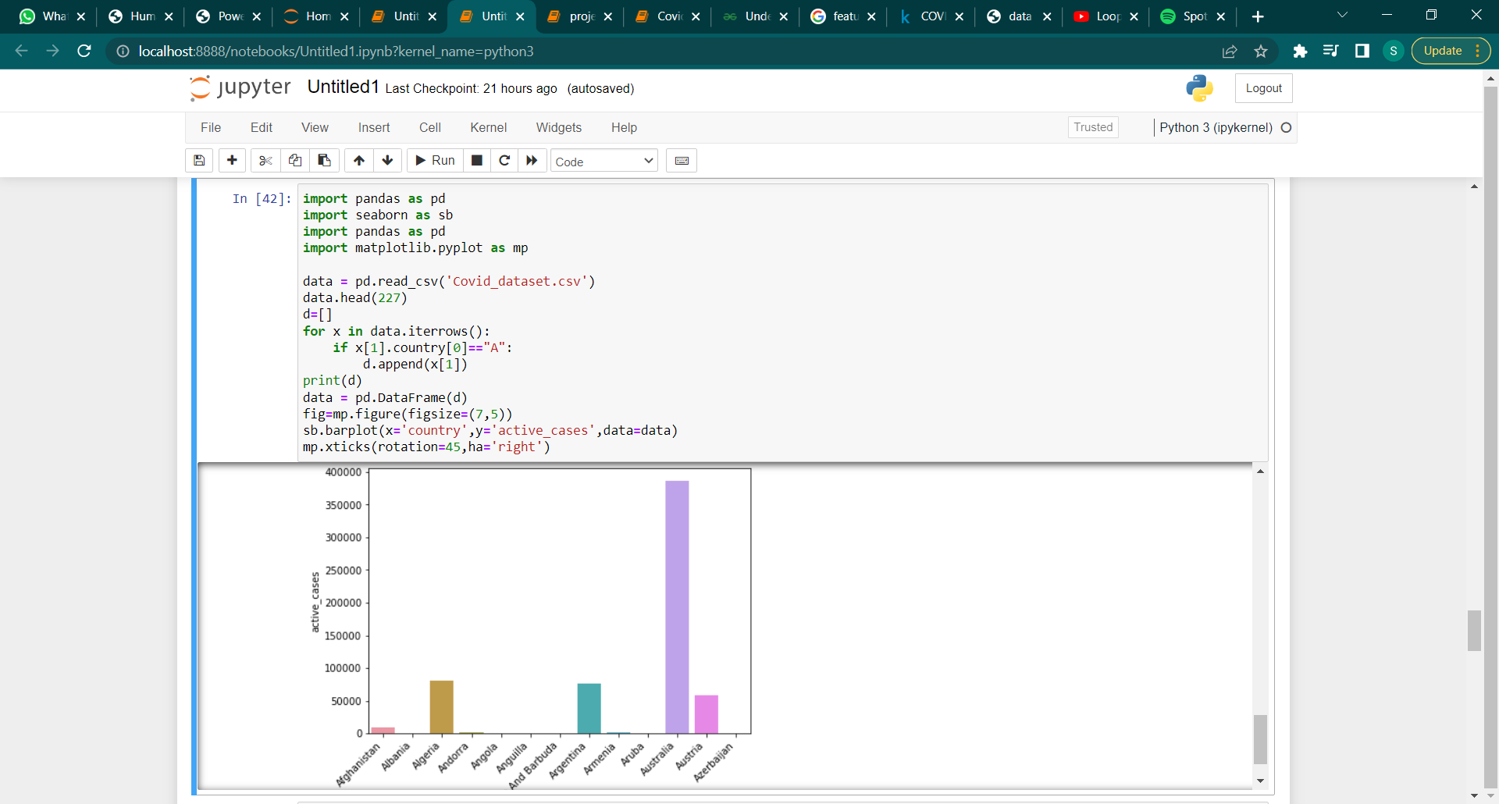
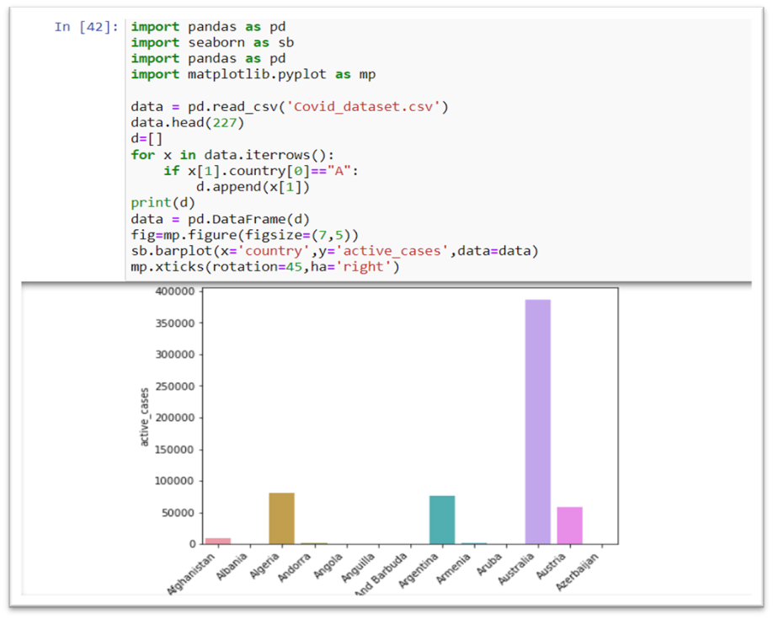
Country wise Covid cases till June 2022
So, to make it clear and foir proper visualization we extracted the country names based on alphabetical order for example, if we want to visualize only in between the particular country with the total_confirmed cases where country name starts only with particular alphabet (“A”, “B”, “C”, ….. , “Z”).Then we done this the following way:-

Slide 11
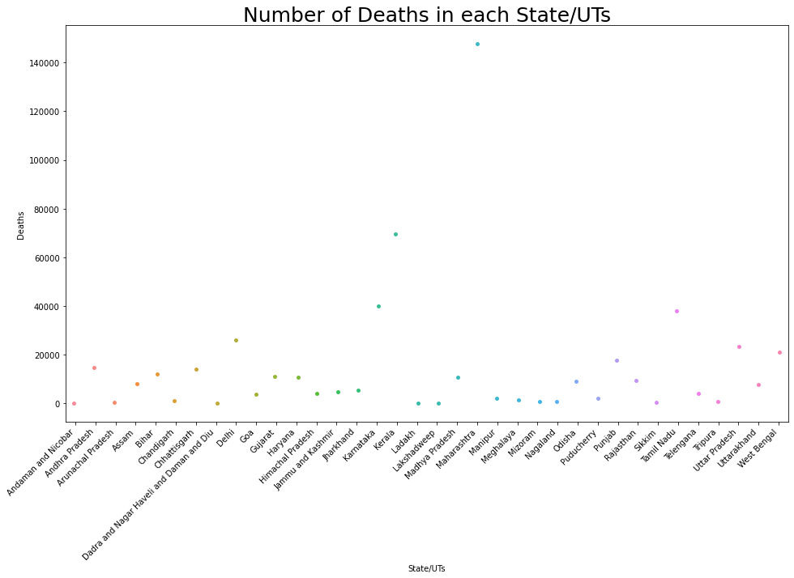
State wise Covid cases of India till June 2022
In this we have the dataset of covid-19 cases in India .As there are 28 states and 8 union territories in India so it is easier to visualize them together.

Slide 12
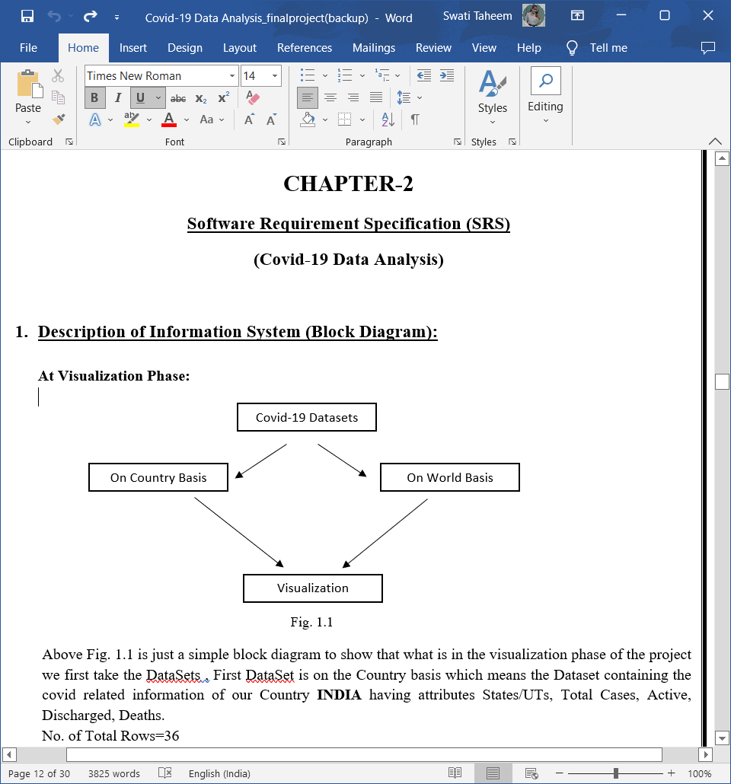
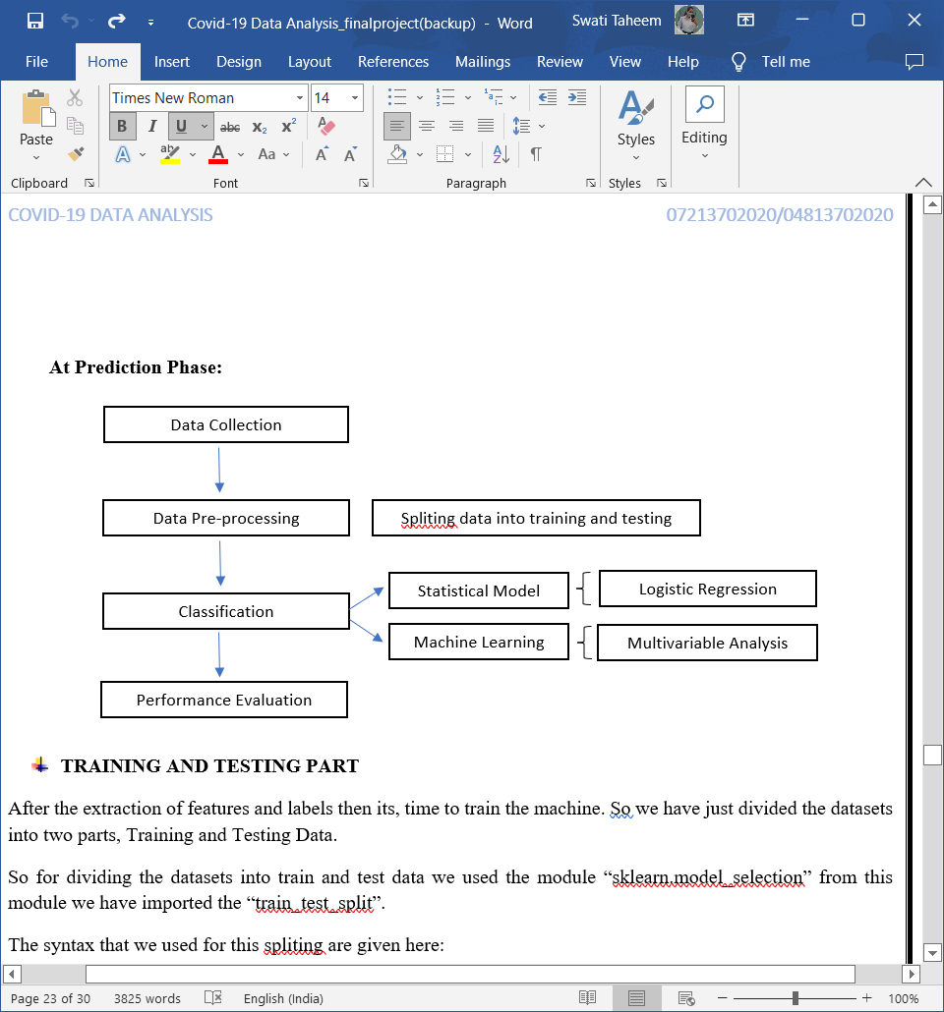
Diagrams Used:
Block Diagrams

Slide 13
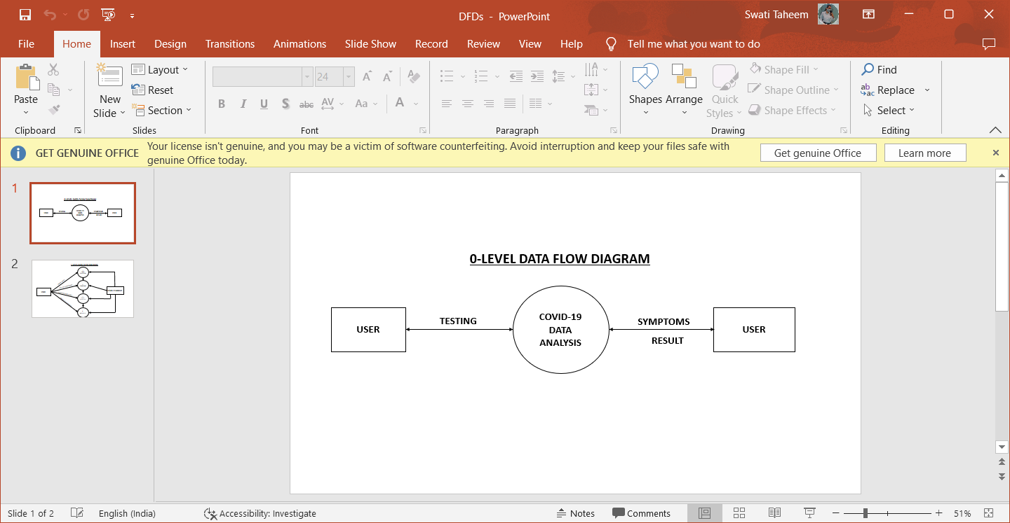
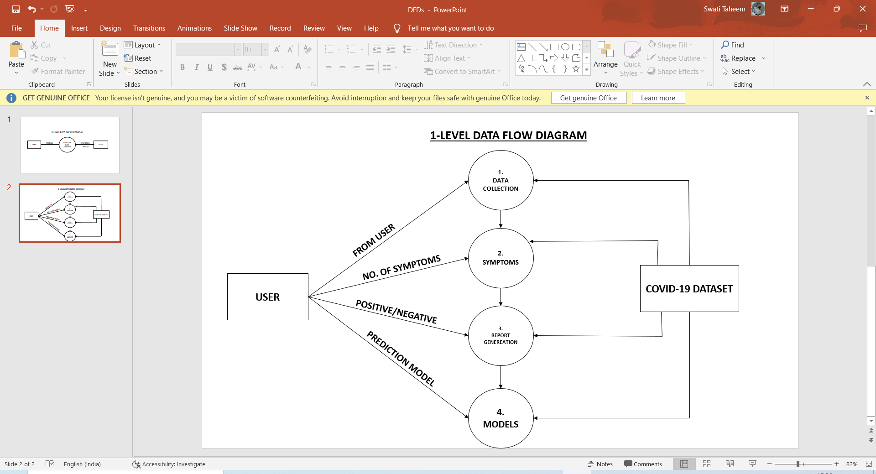
Dfd’s:

Slide 14
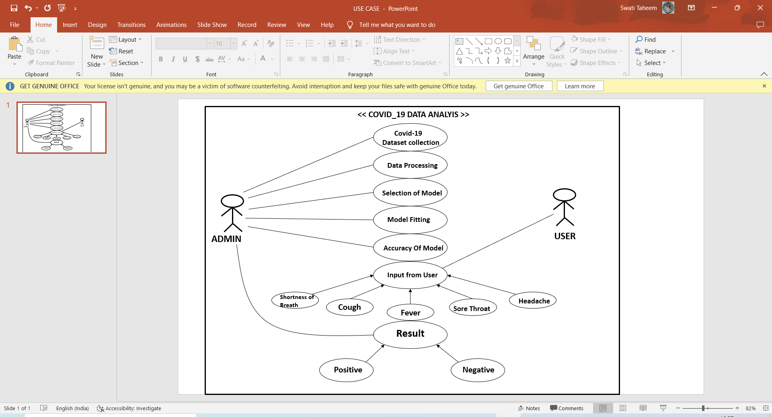
Diagrams Used:
Use Case:

Slide 15
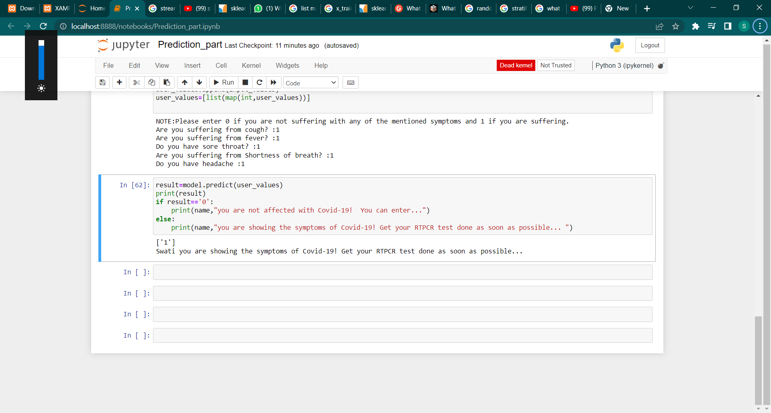
Prediction of Covid-19
Here comes the prediction part on the dataset of initial clinical symptoms of covid-19.
In this we first train and test the data according to need and for model.
Applying different types of model to test the best suited model for the prediction.
Finalizing the LOGISTIC REGRESSION model and checked the accuracy.
Taking general input and symptoms from the user to predict whether person is suffereing from the covid-19 virus or not.
Below is the final output:

Slide 16
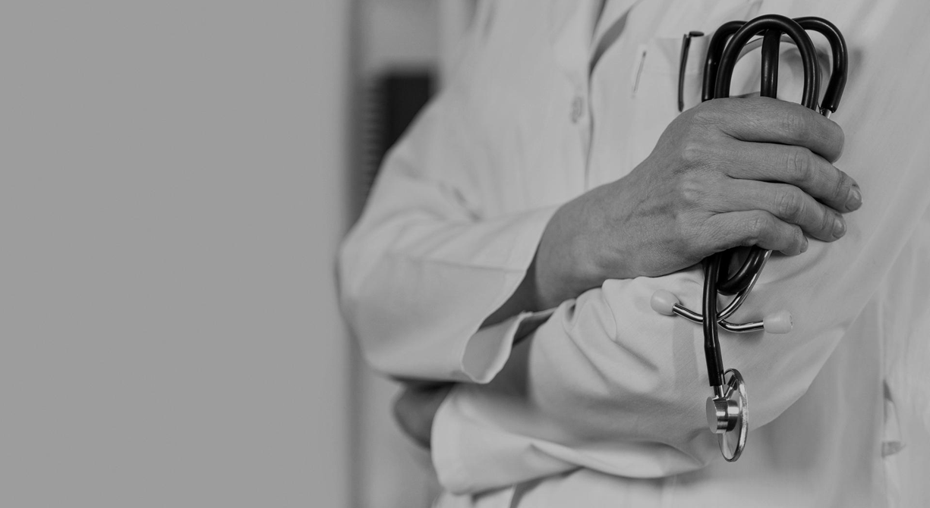
A PICTURE IS WORTH A THOUSAND WORDS
Thank you doctors, nurses, pharmacists, healthcare workers, and more for making sacrifices to commit to the fight against COVID-19.

Slide 17
THANK YOU

